Slide 1




12 December, 2021
Innovate! Be responsible for sustainability.

Slide 2
Time is too valuable for getting out of the car for every time when you want to pay for something.
a
Pay fast and easy
No need to leave the car for payment.
Pay everywhere with a single app.
Seamless management of payment for companies and their employees.
Our world can not afford paper receipts anymore.

Slide 3


Persona Card
All Stakeholders of our Payment Eco-System
Barnie
Ahmet
Car Drivers
Car Owners
Leasers
Corporate Drivers
Municipalities
Fueling&Charging Stations
Franchises
Parking
Public Transport(Ferries)
Car Wash
Car Leasing Companies
“I want to pay and leave as soon as possible.”
“When I buy my coffee I want my dad to pay for it.”
Male, 18-45 years old, White Collar Employee
Male, 20 years old, University Student.
Emma
Ayşe
“I want to be able to pay in each charging station default by company.”
“I want to pay as easy as possible without leaving my car.”
Female, 30-45 years old, White Collar Employee.
Female, 65 years old, Retired, Dog Owner.

Slide 4
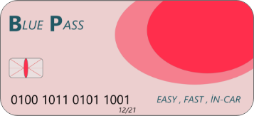
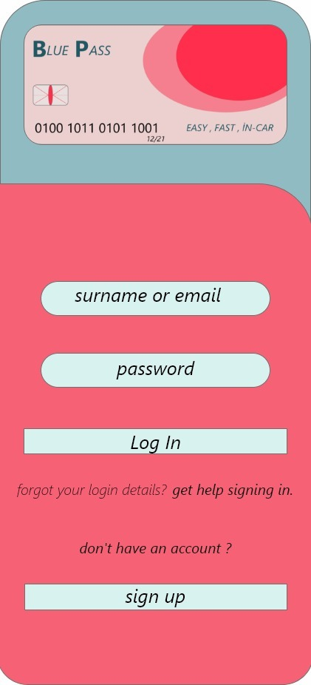



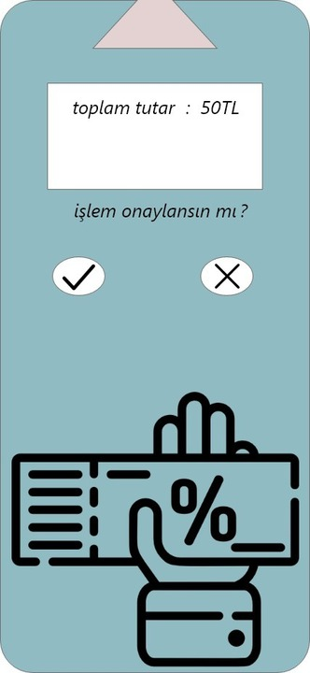
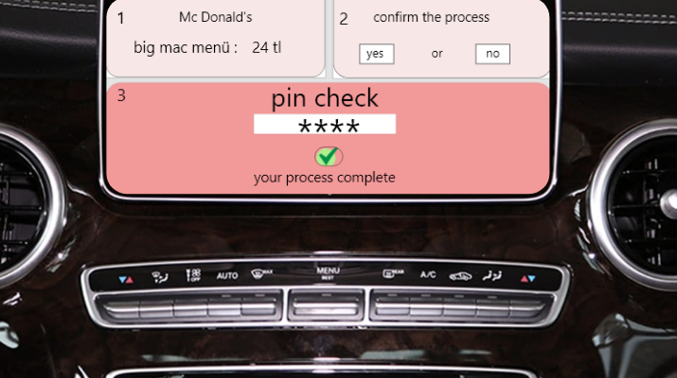






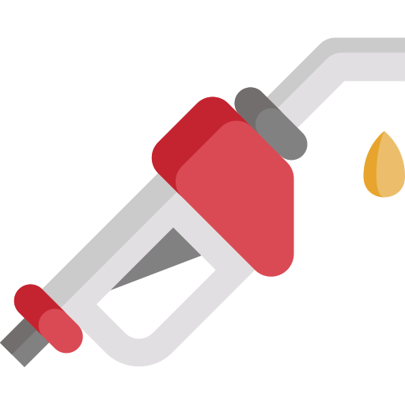
BluePass Easy, Fast, In-Car
Username
Payment Info
Company Info
Account Creation
Password
Payment PIN
Real Person
Business Person
Company Owner
Payment Completed
Examplary Use-Case
Mobile App
Head Unit
I want to pay with BluePass in my car
I want to pay my ferry from Istanbul to Bursa with BluePass
Mobile App
Head Unit
Rental Company assigns the plate to Ayşe for 2 days
I want to buy gas in any fueling station with my Corporate BluePass
Mobile App
Head Unit
His company assigns corporate car to Barnie’s BluePass including Company Card

Slide 5
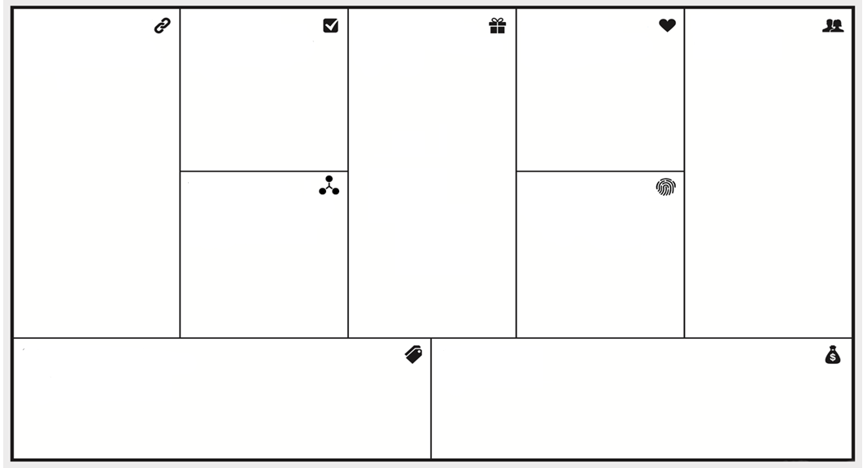
Business Model Canvas
Key Partners
Key Activities
Value Propositions
Customer Relations
Customers
Municipalities
Fueling&Charging Stations
Franchises
Parking
Public Transport(Ferries)
Car Wash
Car Leasing Companies
… and many more to come.
With our scalable digital platform our vision is integrating as many partners as possible.
Providing a secure, reliable, sustainable digital ecosystem so our customers and stakeholders can perform thousands of purchases each day.
Significant reduction of paper need in Daily finances
Offering new locations to customers.
Marketing solutions to stakeholders.
Integrating Loyalty Program.
Car Drivers
Car Owners
Leasers
Corporate Drivers
Some key aspects of customers:
Young, Tech-Savy(Y,Z Generation) who doesn’t want to löse any time just for payment
People who can’t leave their cars: such as disabled or who doesn’t want to leave their beloved ones in the car
Business customers who doesn’t want to be limited to certain places for getting a service exp:fueling only one brand.
Fast, Easy, In-Car payment.
Scalable In-Car payment solution that can be used inter-branded.
Reduction of physcial receipt usage to contribute and build a sustainable World.
Mobile solution for customers, web services for franchises and companies.
Due to a unified payment solution franchises will miss as less customers as possible.
For companies simpliest payment management for employee turnovers.
Key Resources
Channels
Software Developers
Sales Person
Independent from location or brand our customers can use our payment solution with great ease.
Usage in mobile device or In-Car head unit.
Cost Structure
Revenue Streams
Delivery Hero is charging up to %22 of every transaction that goes through its ecosystem. We as a start-up aim to have one tenths of that rate. Which means %2 in each transaction from the sellers.
Standard costs for cloud as a service.
Development costs.
Costs for the search of new stakeholders.
Marketing Costs

Slide 6
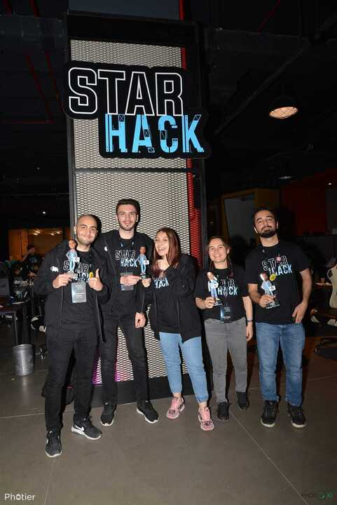
Thank you for your attention!
Team BlueFlags

Slide 7
Time is too valuable for getting out of the car for every time when you want to pay for something.
In digital world people want to pay faster because they have less time.
People want to pay In-Car because they might have disabilities or they don’t want to leave their loved ones alone in the car.
People do not want to download bunch of apps for every different kind of payment.
Companies want to manage their time more effectively because they don’t want to lose time over tracking finance of their employees.
We have to reduce paper consumption for credit card payments because according to ClimateAction.org just «in US every year, receipt use consumes over 3 million trees, 9 billion gallons of water, and generates over 4 billion pounds of CO2 (the equivalent of 450,000 cars on the road) and 302 million pounds of solid waste during production.»¹. In short our world can not afford that.
1 https://www.climateaction.org/news/report-skip-the-slip-environmental-costs-human-health-risks-of-paper-receip

